Slide 1

Balochistan Education Programme
Assessments and Research around Literacy Boost Program under
(BEP).
Notes:
“If you don’t know where you are going how will you know when you get there?”

Slide 2



Balochistan Education Program (BEP)
2010 to 2014
01
3 Districts
Quetta, Killaabdullah ,Mastung
Increase
Access
Health and Nutrition
Awareness
Increase
Quality
Objectives
60%
40%
Planning and Budgeting
Support
340 Schools

Slide 3
BEP- Capacity Building Programs
02
ECE
CHFE
SHN
Literacy Boost
Objectives2
Increase Quality
Emergent Literacy and Math
ELM
DRR
Peace Education
Notes:
Comprehensive approach
Holistic Development of Students
Cognitive
Literacy boost
Numeracy boost
Assessment
Physical Development
Co-curricular activities
CFHE
Social & emotional Development
Child clubs
CPCR
DRR
Peace Education
Linguistics Development
Mother Tongue

Slide 4
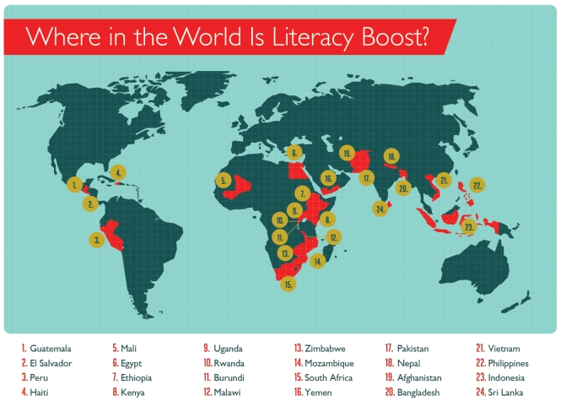
Literacy Boost
03
Learning to read and Reading to Learn through Literacy Boost
Literacy Boost is Save the Children's innovative,
evidence-based program to support reading skills
development in young children.
24 Countries

Slide 5
Literacy Boost- Mother Tongue – 2012-2013
04
Project Objective
To assess and enhance the reading levels and reading comprehension of children and to conduct evidence-based policy dialogue on Mother Tongue as medium of instruction .
Total out Reach was 1160.
Assessment
3 Pronged Strategy .
411
749
Teachers Training
Research Question:
Will students’ Mother Tongue and Urdu language scores improve at the end of the project?
Community Action

Slide 6
Literacy boost developmental domains
05
Physical
Emotional
Linguistic
Cognitive
Social
Literacy boost teaching methodologies are based on child centered approach that focuses on promoting creative writing and analytical thinking for learners rather
than rote learning
Listening and Speaking skills
Imaginative, logical and critical thinking of children
Vocabulary development
Sequencing sentences/situation while talking
Making predictions

Slide 7


Literacy Boost - Baseline Results
06
Overall summary of percentage scores achieved by Literacy Boost and Comparison students
Literacy Boost
Comparison Schools
 | 90
 | 80
 | 70
 | 60
 | 50
 | 40
 | 30
 | 20
 | 10
 | 0
84%
80%
43%
40%
30%
13%
Letter Recognitions
Reading Accurately
Comprehension

Slide 8


Endline Results
07
Overall summary of gains achieved by Literacy Boost and Comparison students
55
50
45
40
35
30
25
20
15
10
05
0
15% More
13% More
% Percentages
10% More
Literacy Boost
Comparison School
Literacy Boost
Comparison School
Literacy Boost
Comparison School
Learning the ABCs
Reading It Right
Connecting The Dots

Slide 9
Numeracy Boost
08
Project Objective
To Strengthen the basic Math skills of early grades( Focused Grade 2).
Duration
January to October 2014
Assessment
3 Pronged Strategy .
Focus on Early Grades Math Skills
Number and Operation
Geometry
Measurement
Teachers Training
Community Action
Notes:
Recent research shows children’s early math abilities is a predictor of later school success (Duncan, 2007)
Our own research with Literacy Boost shows children making gains in both literacy and numeracy (Nepal, Malawi)
A strong foundation in math is necessary to succeed in school and in the real world

Slide 10
T
H
A
N
K
S

